Slide 1
Uncertainty
Chapter 13

Slide 2

Read Ch 13!
This is core material for the rest of this course
Understanding Bayes Nets and DBNs requires intuitive understanding of some basic probability concepts

Slide 3
Uncertainty
Until now....propositions are T, F, or unknown
Real environments are not so certain
partially observable
noisy sensors
unexpected events in dynamic environments

Slide 4
Probability Interpretations

Slide 5
Probabilities

Slide 6
Probability and Wagers

Slide 7
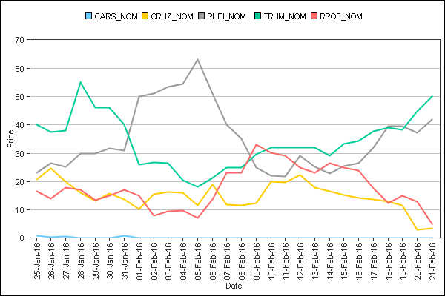
Probability and Wagers

Slide 9
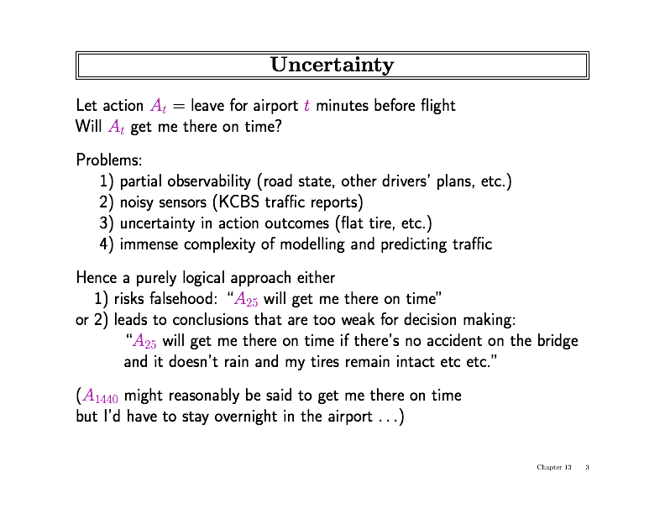
Example

Slide 10
Example

Slide 11
Example

Slide 12
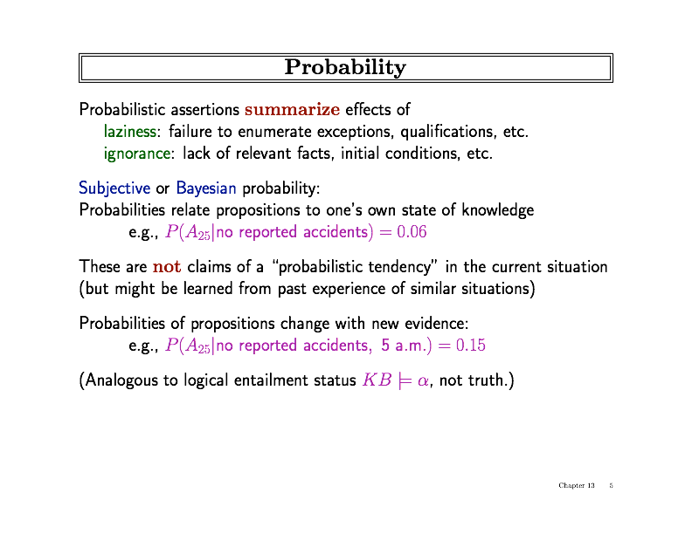
Probability
Instead of absolute statements, use probability to summarize uncertainty
Probabilities relate to the degree that an agent believes a statement to be true

Slide 13
Probability
Instead of absolute statements, use probability to summarize uncertainty
Probabilities relate to the degree that an agent believes a statement to be true
The probability changes with new information (evidence)

Slide 14
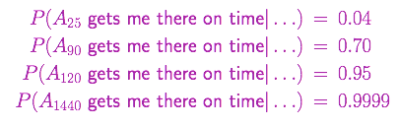
Decisions with Uncertainty
Which action should I choose with the following beliefs
Depends on preferences, willingness to take risk

Slide 17
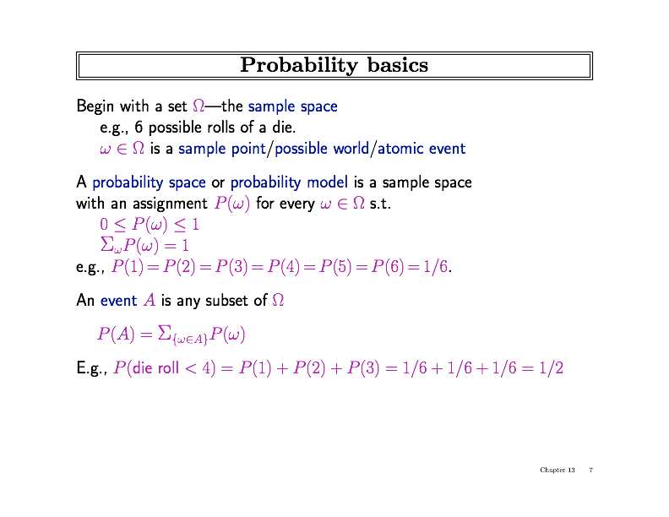
Probability Basics

Slide 18
Probability Basics

Slide 19
Probability Basics

Slide 20
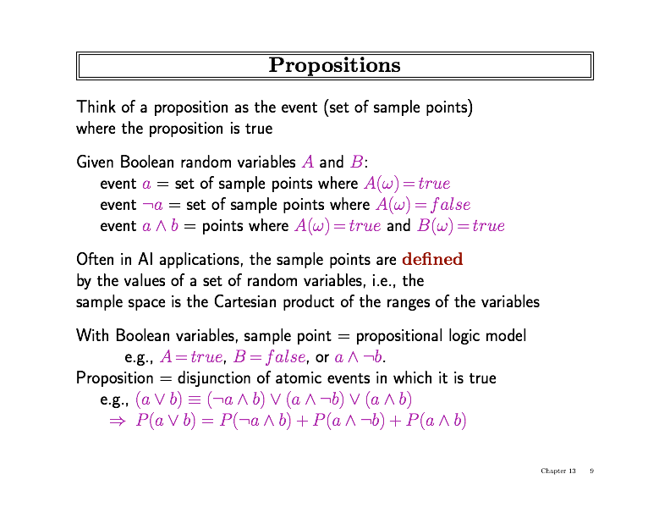
Propositions

Slide 21
Propositions

Slide 22
Propositions

Slide 23
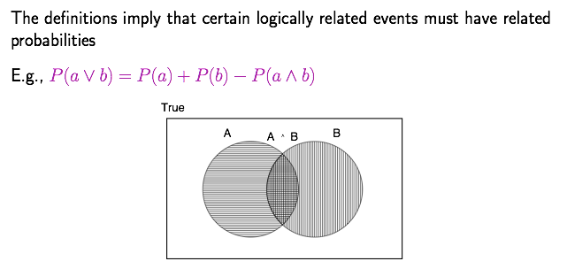
Why use Probability?

Slide 24
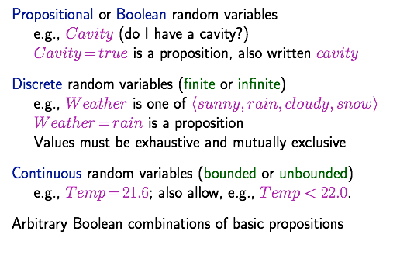
Syntax for Propositions

Slide 25
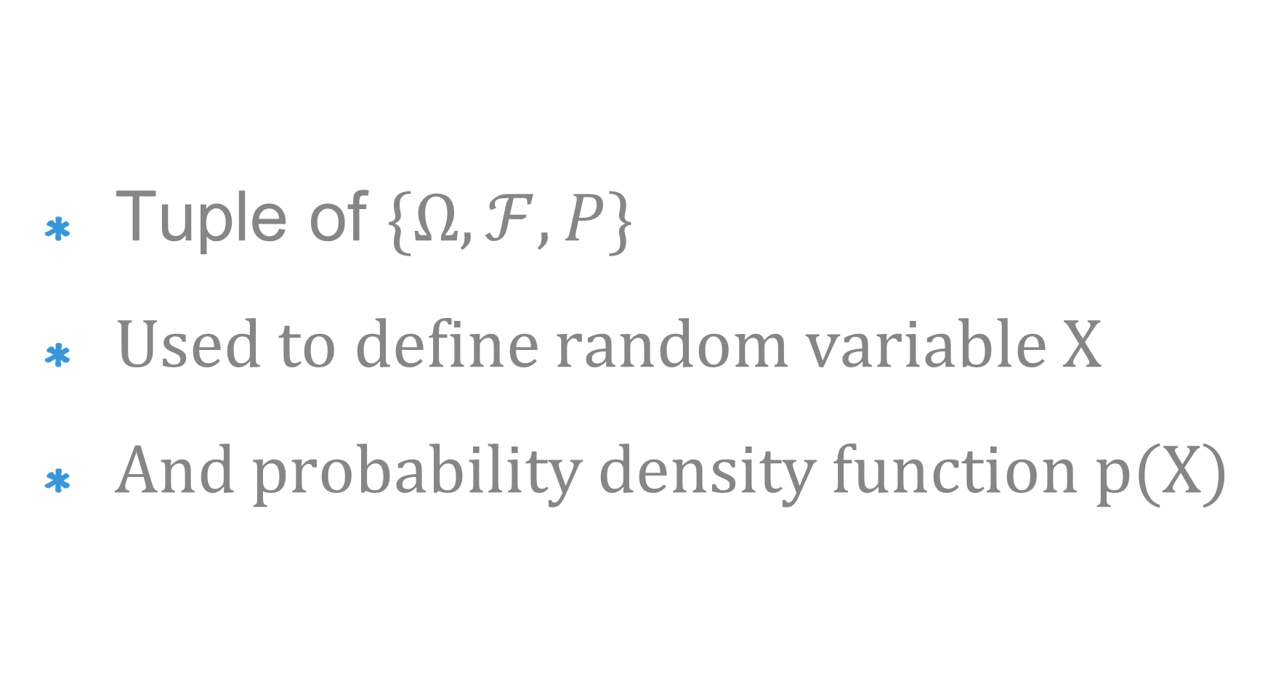
Probability Model
Tuple of $\{Ω, ℱ, P\}$
Used to define random variable X
And probability density function p(X)

Slide 26
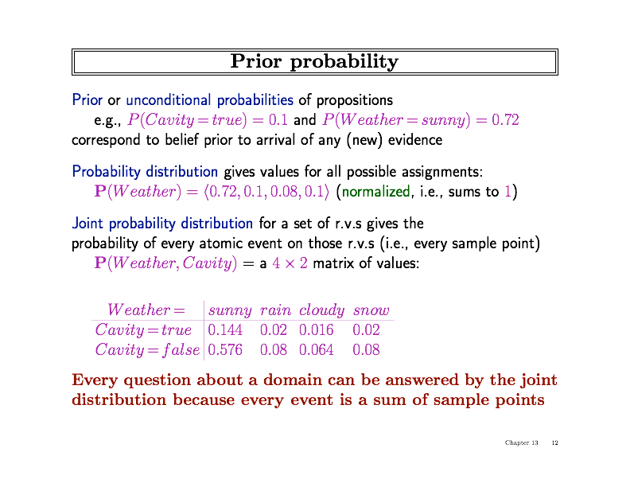
Prior Probability

Slide 27
Prior Probability

Slide 28
Prior Probability
0.2

Slide 29
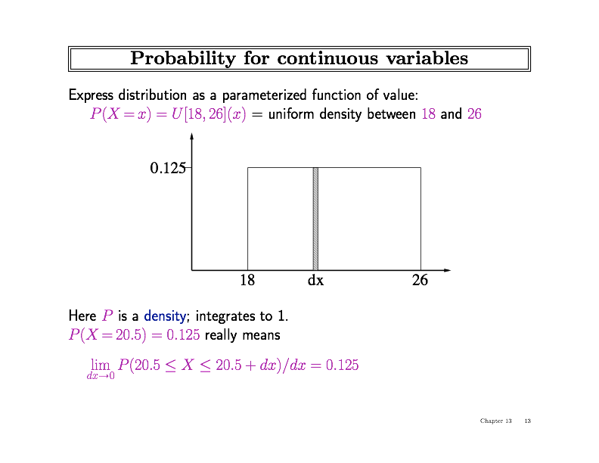
Continuous Variables

Slide 30
Continuous Variables
Density integrates to 1, in this case (26-18)*0.125 = 1
Now consider U[1.0,1.2]: We require (1.2-1.0)*x = 1
So x=5. Note that p(x)>1, different from discrete case

Slide 31
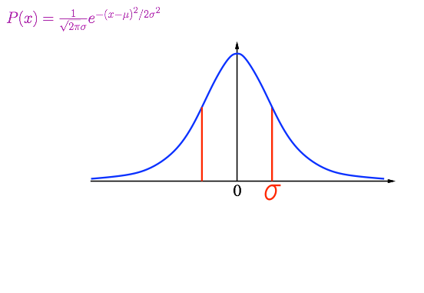
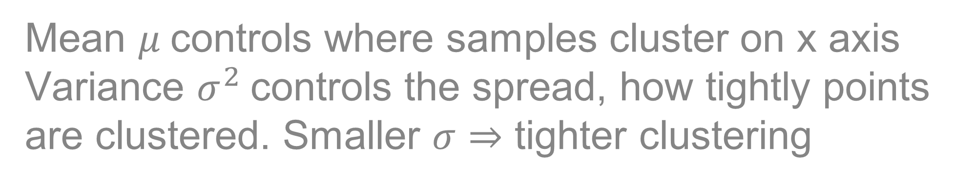
Continuous Variables
Mean $μ$controls where samples cluster on x axis
Variance $σ^{2}$controls the spread, how tightly points are clustered. Smaller $σ⇒$ tighter clustering

Slide 32
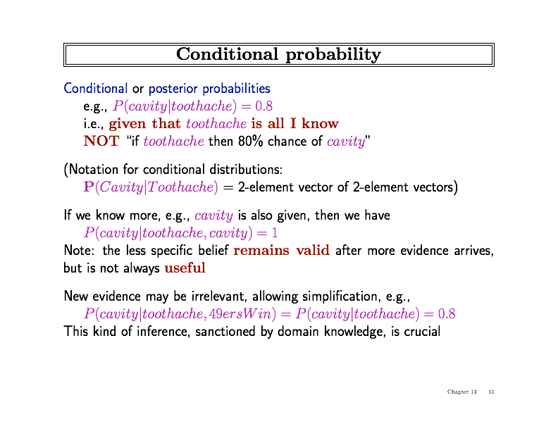
Conditional Probability

Slide 33
Conditional Probability

Slide 34
Conditional Probability

Slide 35
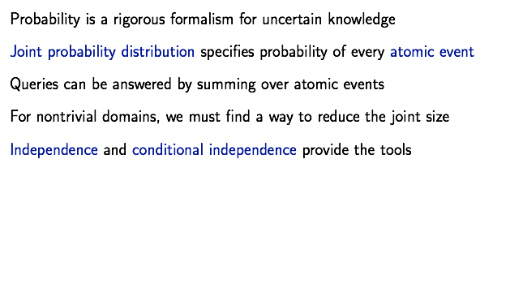
Summary

